Slide 1

Detection of Face Forgery in Videos using Deep Learning
Team Details
Team Number: H5
Sl.Num | Student Name | USN | Roll Num. | Division
1. | Somil Yadav | 01FE21BCS192 | 130 | A
2. | Harsh Kashyap | 01FE21BCS238 | 332 | C
3. | Abhinav Anand | 01FE21BCS239 | 333 | C
4. | Sanjana Habib | 01FE21BCS020 | 302 | C
Guide: Prof. Guruprasad Konnurmath

Slide 2

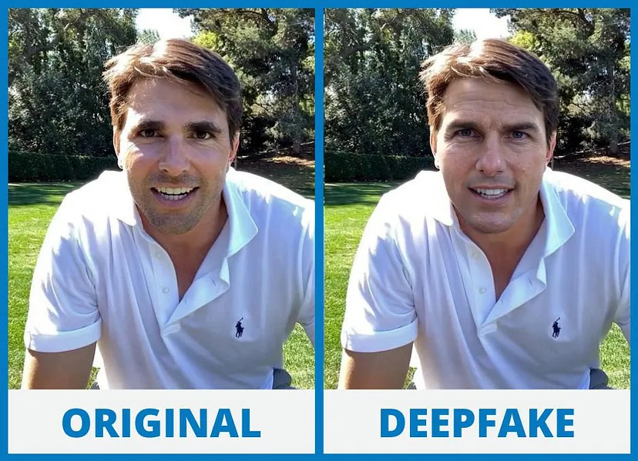
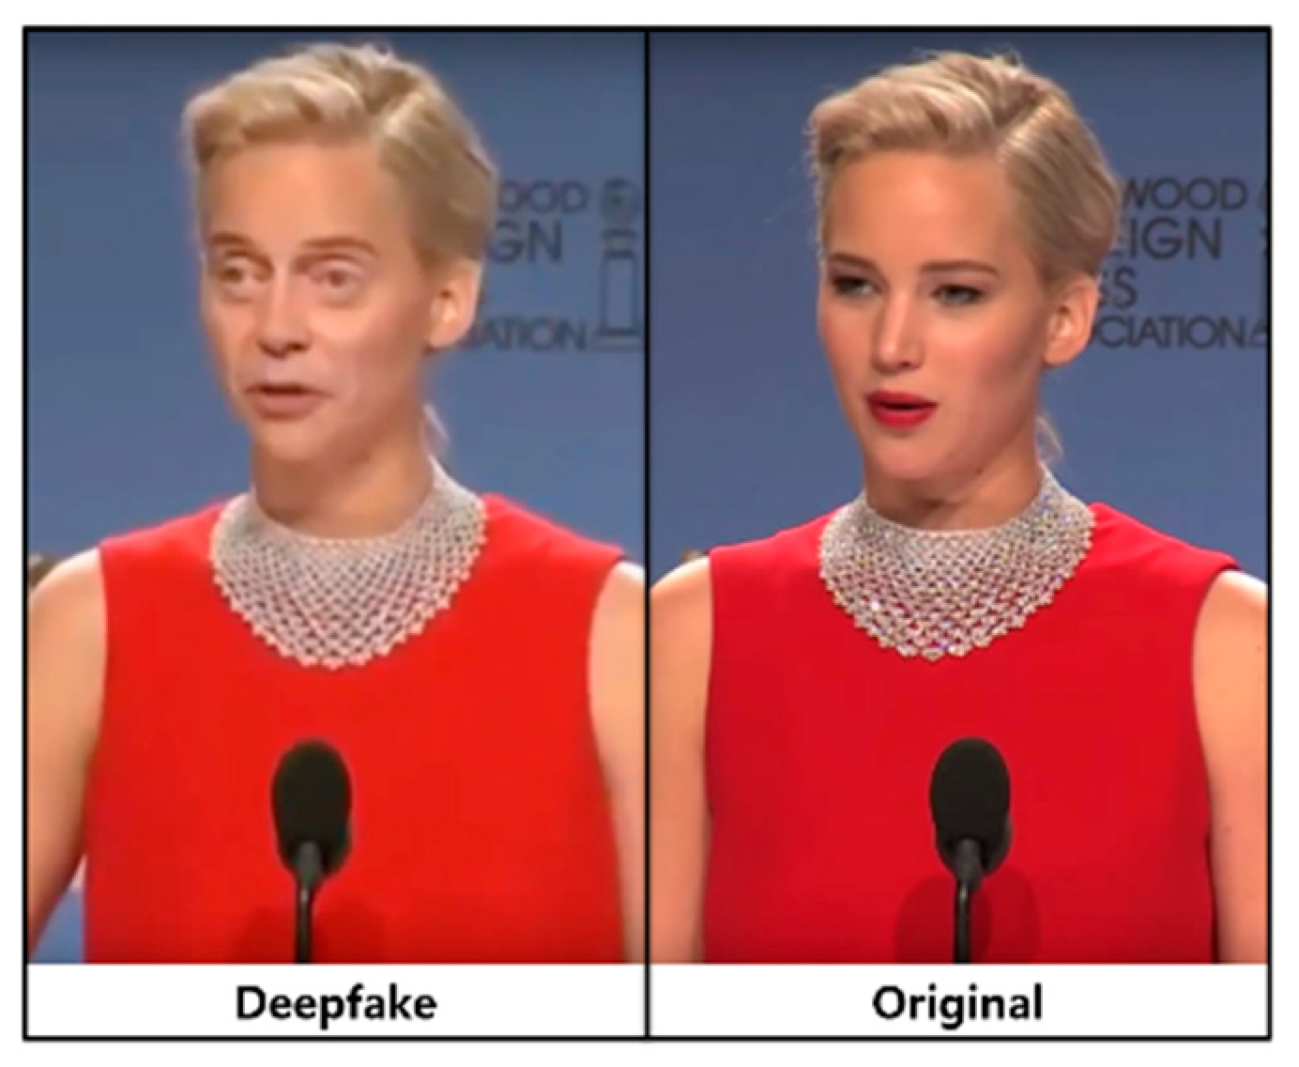
Introduction
Deepfakes are synthetic media, typically images or videos, created or altered using deep learning techniques, particularly Generative Adversarial Networks (GANs).
They involve the generation of highly realistic fake content, often indistinguishable from genuine media, through the manipulation of facial features, expressions, and voices.

Slide 3
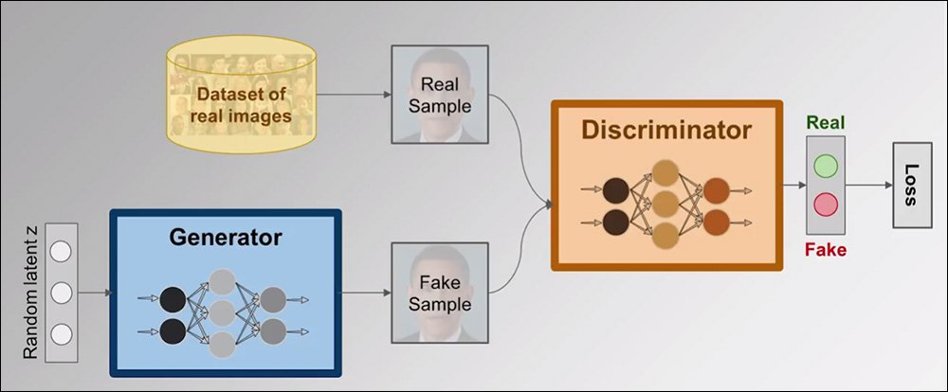
Introduction​
DeepFake generation using GAN
Generative Adversarial Network (GAN) is an advanced deep learning method for generating synthetic images using 2 types of neural networks: a generator and a discriminator. The generator creates images while the discriminator evaluates these images and tries to determine whether this image is real or not. Active cross-training helps the generator to adapt to the real image to the level of generating realistic deepfake images that are difficult to detect. The illustration below shows how GAN models work.

Slide 4
Problem Statement
To Develop a robust deep learning model combining EfficientNetB4 (CNN) and GRU (RNN) to detect face forgeries in videos. The model aims to accurately identify forged media by leveraging spatial features and temporal inconsistencies.
Final objectives
Develop CNN model using EfficientNet for image classification.
Integrate Custom model and GRU for face forgeries detection in videos.
Create robust face forgery detection with diverse dataset training.

Slide 5
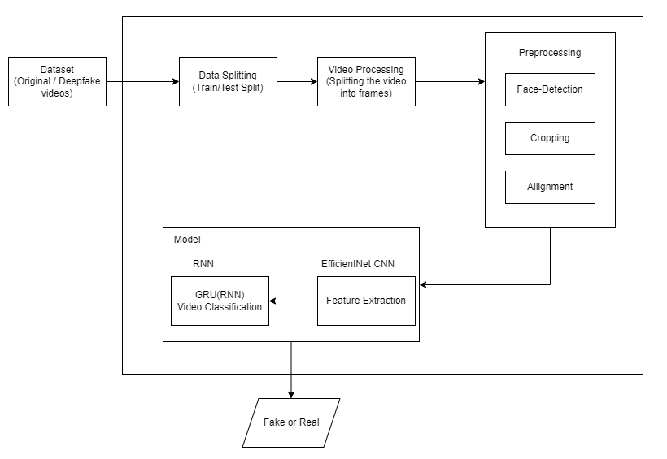
System Design

Slide 6
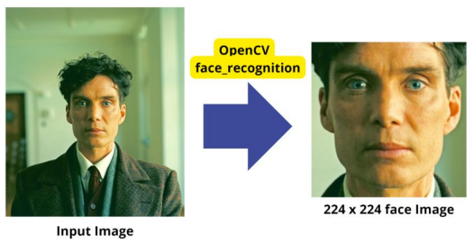
Dataset
Dataset: Deepfake Detection Challenge (Kaggle)
The dataset consists of .mp4 files, each with a duration of 10 seconds, totaling approximately 4GB in size. Accompanying the .mp4 files is a metadata.json file, which contains the following columns:
filename: The name of the .mp4 file.
label: Indicates whether the video is REAL or FAKE.
original: The source or reference video from which the clip is derived.
split: Specifies the dataset split (e.g., train, validation, test)
We have used preprocessed data from the general dataset of the DFDC competition. Frames with clear outlines of the face were cut from all the images with a modified size of 224x224 pixels using “OpenCV” image processing tools and “face_recognition” module.

Slide 7
Dataset Description
Data Preparation
Initially, the dataset consisted of 95,634 images of 224x224 sized faces.
1) Distribution of real and fake images:
• Fake Images: 79,341
• Real Images: 16,293
2) Image size in bytes: 224 * 224 = 50,176 B (49 KB)
3) To equally distribute images, we choose 16,000 real and 16,000 fake images.
• Total images for training = 16,000 (real) + 16,000 (fake) = 32,000 images.
4) Total dataset size = 49 KB * 32,000 = 1,568,000 KB (or 1,531 MB)
5) Total Videos: 800 (400 training and 400 testing)
6) Total Size: 4 GB
Data Splitting
Splitting data into training, testing and validation sets:
• Training Set: 17,920 (56%) – used to train the machine learning model.
• Testing Set: 6,400 (20%) – used to evaluate the final performance of the trained model.
• Validation Set: 7,680 (24%) – used to tune hyperparameters.

Slide 8
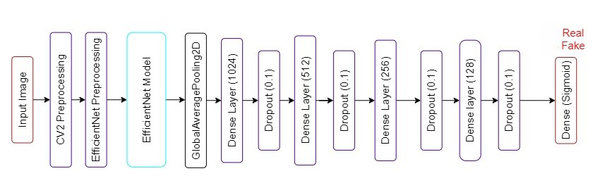
Architecture
Model Architecture
Architecture of our model utilizes EfficientNetB4 and CNN architecture with a custom-designed additional layers. Model architecture diagram shown below:

Slide 9
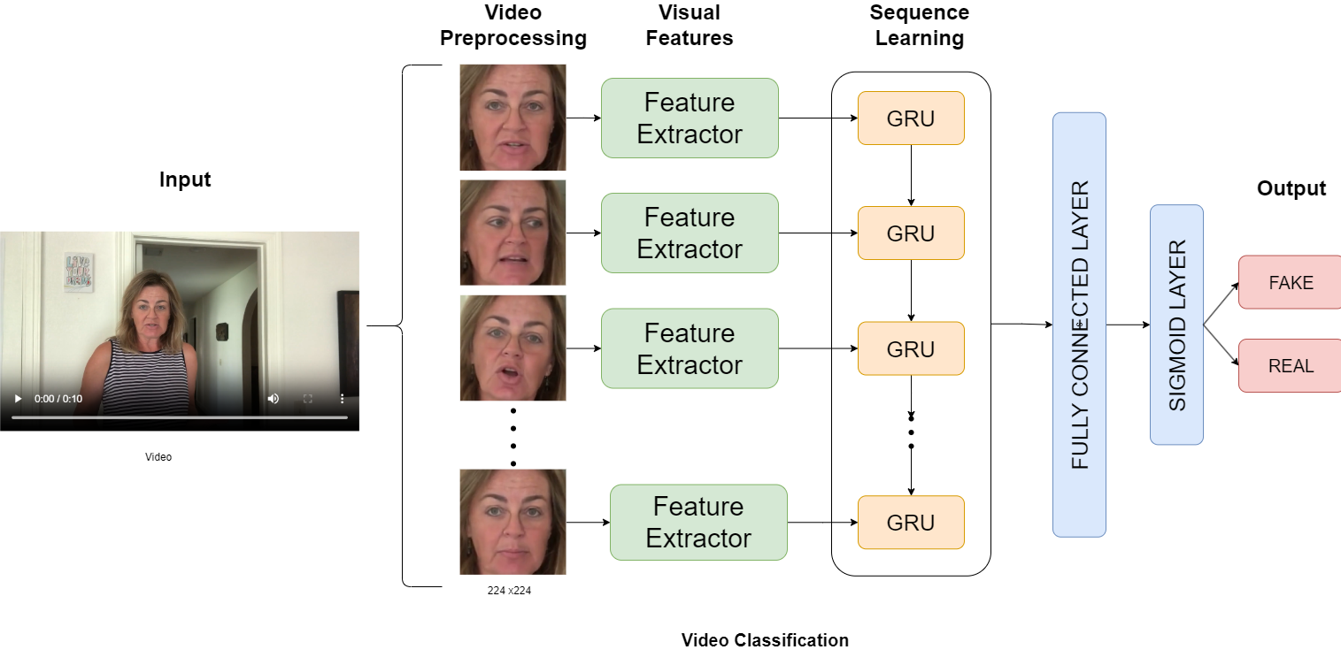
Architecture
Video Classification Architecture
Video frames are cropped to isolate faces using OpenCV, then passed through an EfficientNetB4-based feature extractor. These features are processed by a GRU for sequence learning and fed into a fully connected layer with a sigmoid activation to predict if the frame is fake or real

Slide 10
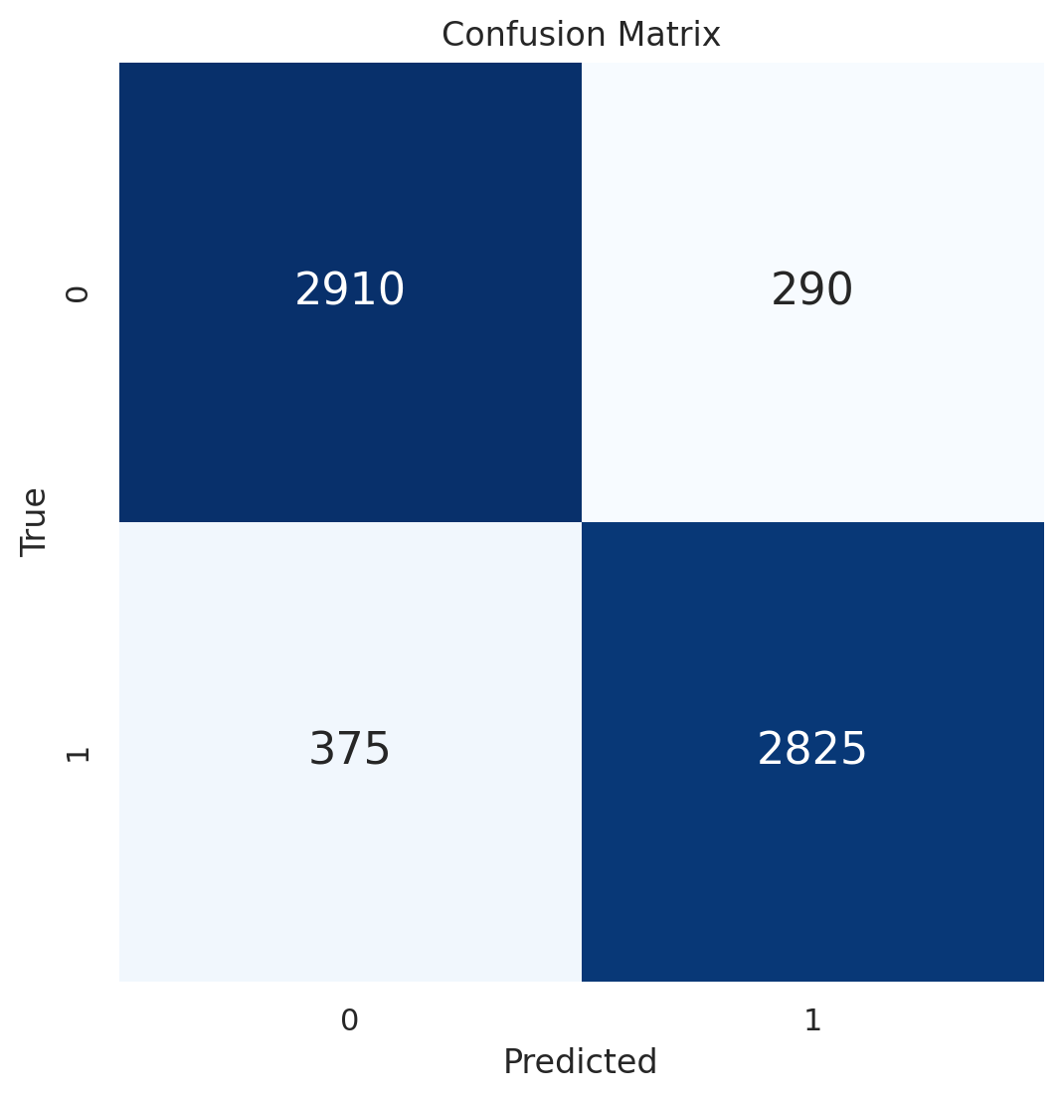
Intermediate Results Analysis
Model Accuracy
Results on Confusion Matrix of EfficientNet B4
Training
accuracy: 0.9840
loss: 0.0450
Validation
val_accuracy: 0.8982
val_loss: 0.3925
Results of the trained model on the Test Set using EfficientNet B4 model:
• Test Loss: 0.2476
• Test Accuracy: 0.8961
• True Positive (TP): 2825 (Correctly identified fake images)
• True Negative (TN): 2910 (Correctly identified real images)
• False Positive (FP): 290 (Fake images identified as real)
• False Negative (FN): 375 (Real images identified as fake)

Slide 11
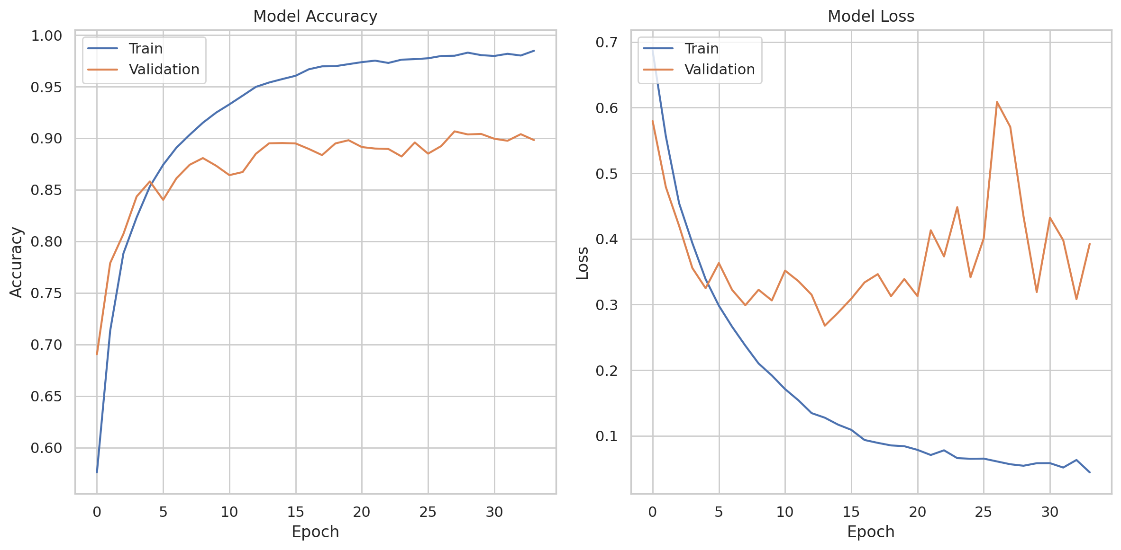
Intermediate Results Analysis
Model Evaluation
In the figure below, is the results of training the model based on historical data on the values of accuracy and loss in training and validation sets.

Slide 12
Results
Model results on the random 20 images sample from the Test Set.

Slide 13
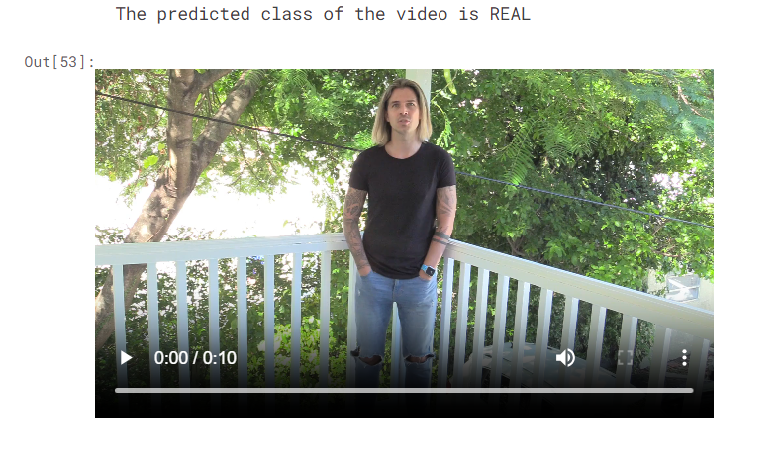
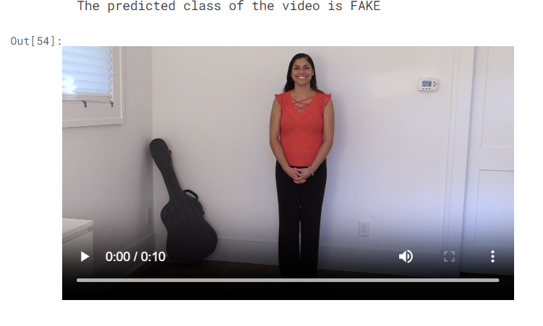
Video Results

Slide 14
References
[1] Roberto Caldelli et. al., 2021, “Optical Flow based CNN for detection of unlearnt deepfake manipulations”, Pattern Recognition Letters vol. 146, pp. 31-37
[2] X. Wu, R. Liu, H. Yang and Z. Chen, 2020 ”An Xception Based Convolutional Neural Network for Scene ImageClassification with Transfer Learning”, 2nd International Conference on Information Technology and Computer Application (ITCA), pp. 26
[3] Ruben Tolosana et. al., 2022, “DeepFakes detection across generations: Analysis of facial regions, fusion, and performance evaluation”, Engineering Applications of Artificial Intelligence vol.110.
[4] B. Dolhansky et. al., 2020, The DeepFake detection challenge (DFDC) dataset.
[5] M. Hossain et al., 2019, ”Deepfake Video Detection using Xception and Local Binary Patterns”, 10th International Conference on Intelligent Systems, Modelling, and Simulation

